Slide 1
Surface Defect Detection of Heat Sinks with Image Segmentation
Cheng Zhao

Slide 2
01
02
03
SMART MANUFACTURING
DEFECT DETECTION
Motivation
BENEFITS
Using machine learning and AI to drive manufacturing.
Using deep learning and computer vision to detect defects during manufacturing process.
Reduction in human labor.
Increased efficiency.
Potential improvement in accuracy.
In-process quality control.
Data-based failure analysis.

Slide 3
Contents
Defect Analysis
U-net
Introduction
Other Achitectures as Backbone
Dataset Description and Exploration
Use Segmentation Models library to implement other architectures as backbone for U-net
Manual implementation of U-net CNN for Image Segmentation
Post-processing of image segmentation results

Slide 4
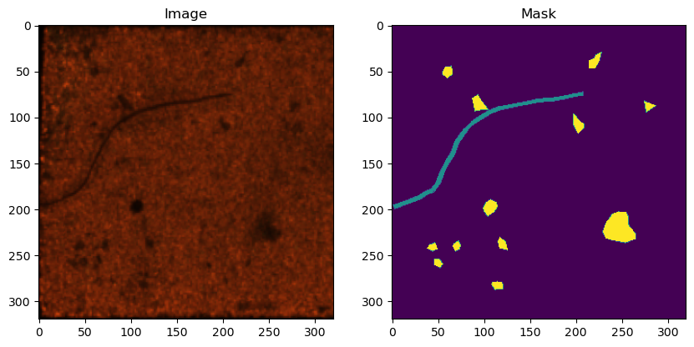
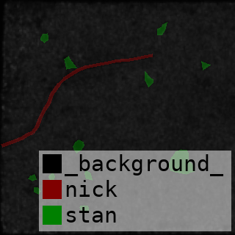
Dataset Description
Link: https://www.kaggle.com/datasets/kaifengyang/heat-sink-surface-defect-dataset.
Citation: K. Yang, Y. Liu, S. Zhang and J. Cao, "Surface Defect Detection of Heat Sink Based on Lightweight Fully Convolutional Network," in IEEE Transactions on Instrumentation and Measurement, vol. 71, pp. 1-12, 2022, Art no. 2512912, doi: 10.1109/TIM.2022.3188033.
Collected and labeled by State Key Laboratories of Transducer Technology, Institute of Semiconductors, Chinese Academy of Sciences.
Dataset contains 1000 images of gold-plated tungsten-copper alloy heat sink surfaces, with defects and their annotations.
Images are labeled into 3 categories:
0 - Background (defect-free area)
1 - Scratch
2 - Stain

Slide 5
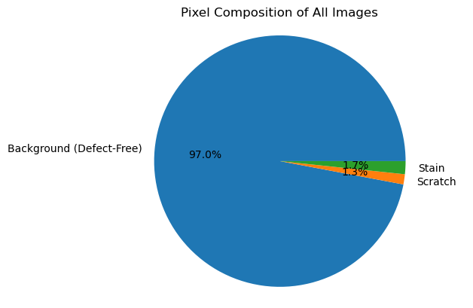
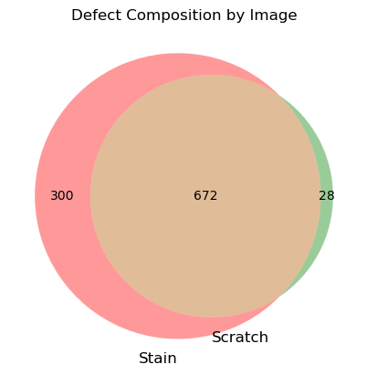
Data Exploration
In terms of pixel composition, most of the area is by far the background.
Stains and scratches only account for 1.7% and 1.3% of all pixels, respectively.
Of the 1000 images, every image has labeled defects.
28 images only have scratch.
300 images only have stain.
672 images have both scratch and stain. Around 2/3 of all images have both scratches and stains.

Slide 6

U-net
Data preparation
Split data into 70/15/15 Train/Validation/Test sets.
Preprocess data by resizing images from 320X320 to 256X256 and normalizing input values.
Followed U-net architecture but halved the number of filters. First two convolutional layers have 32 filters instead of 64, subsequent two convolutional layers have 64, etc.
Track skip connections in contracting blocks and concatenated to corresponding upsampling blocks.
Didn’t add any batch normalization or dropout.
Used batch size of 32 and trained for 40 epochs.

Slide 7
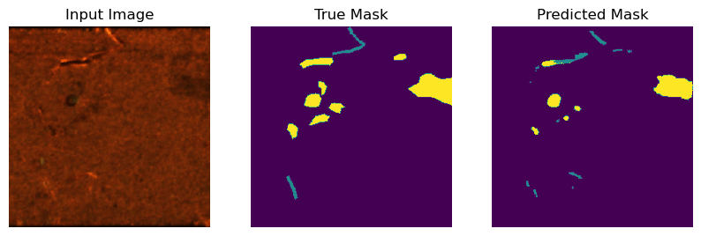
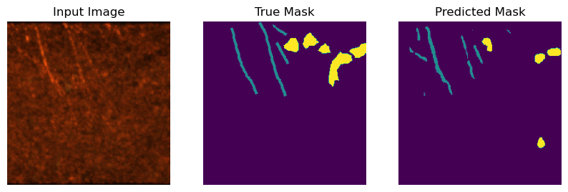
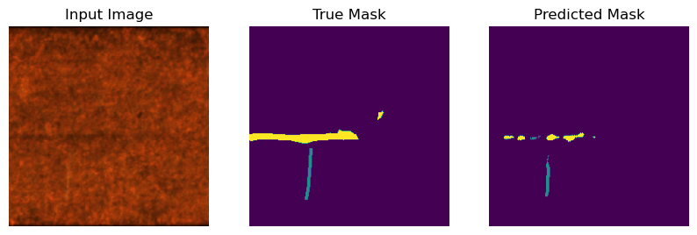
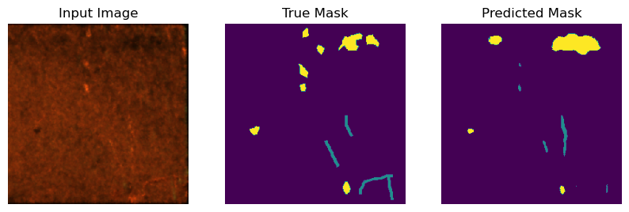
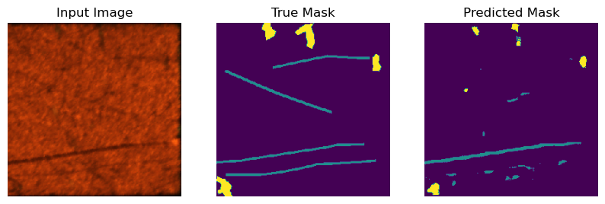
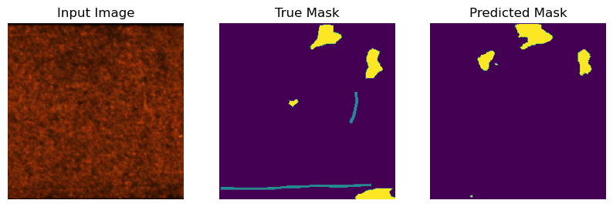
U-net Results
Training Set
Validation Set

Slide 8
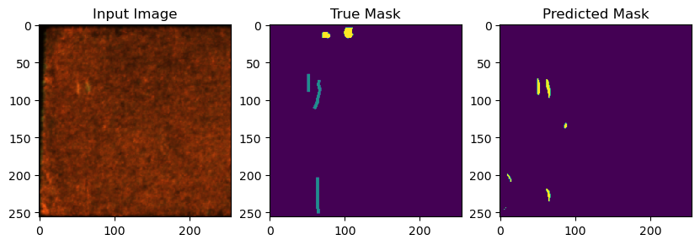
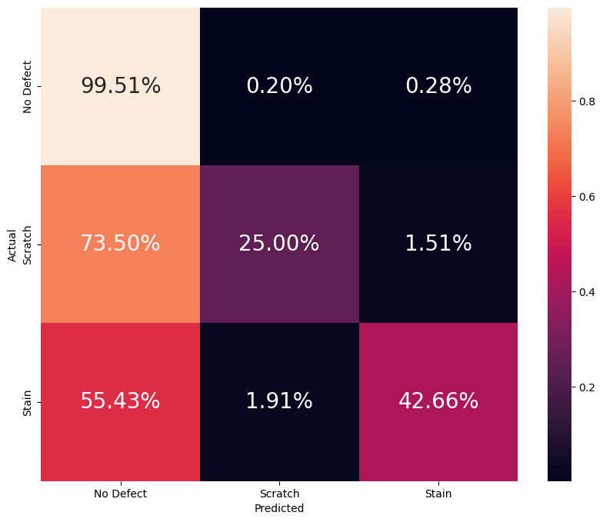
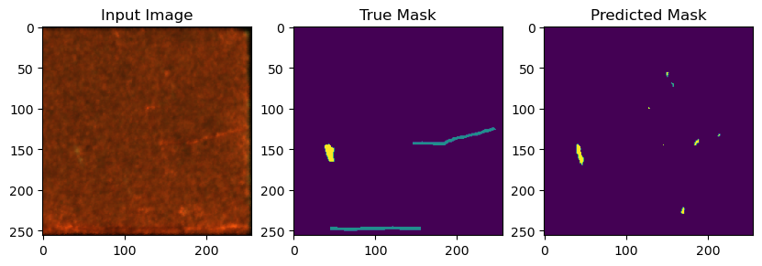
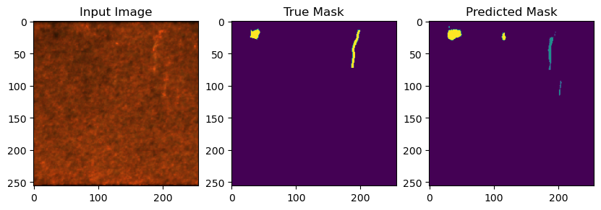
U-net Results - Cont.
Validation Set Confusion Matrix
Examples of Incorrect Predicted Defect Type

Slide 9
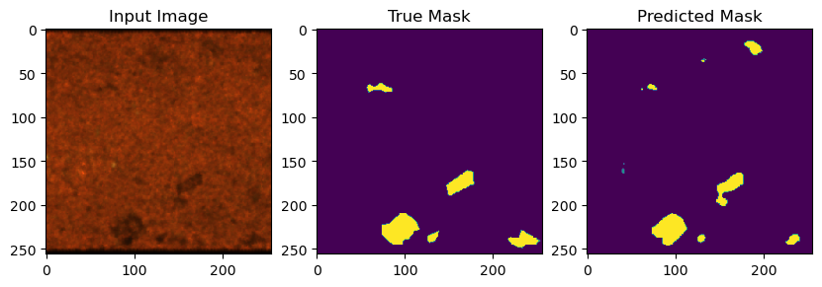
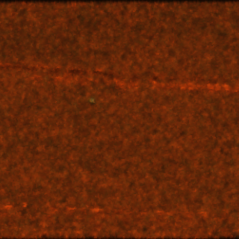
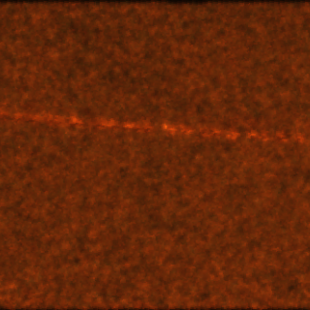
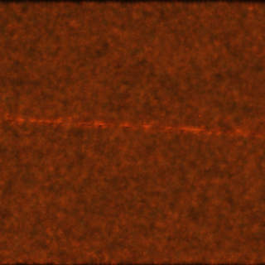
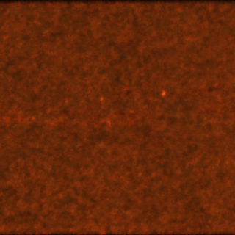
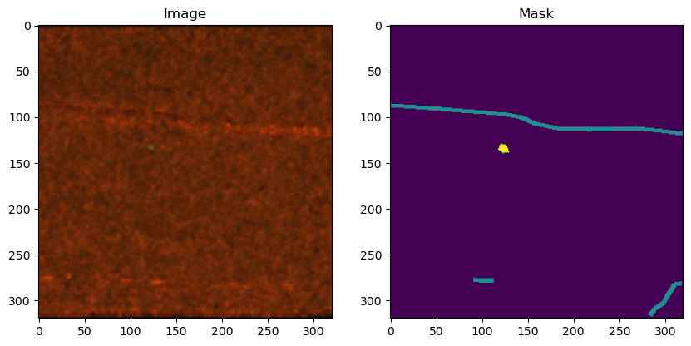
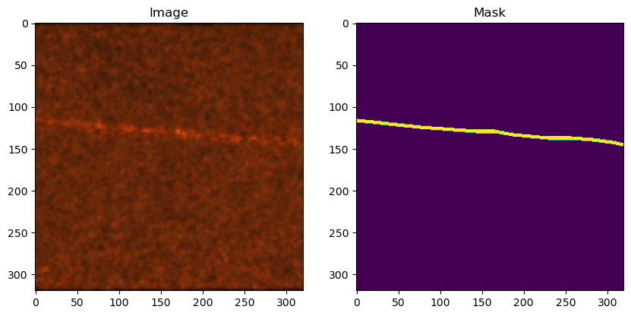
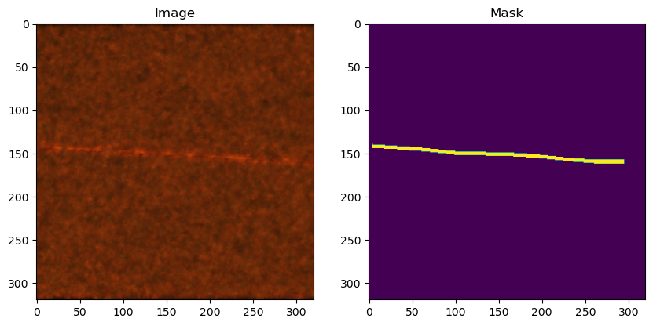
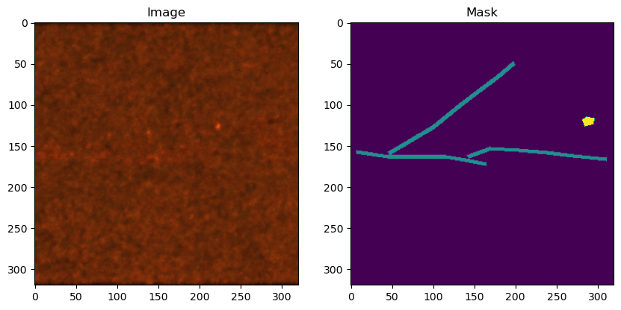
Discussion on Labeling
Labeling is quite arbitrary as the criteria for defects are not very clear. It is sometimes difficult to judge whether a defect is present and also to discern whether or not the defect is a scratch or a stain.
This suggests the Bayes error and the human-level error for the task can be quite high.
There are many instances of defect not labeled as well as mislabeled.
This will also impact the ability for the algorithm to learn and attain high performance.

Slide 10
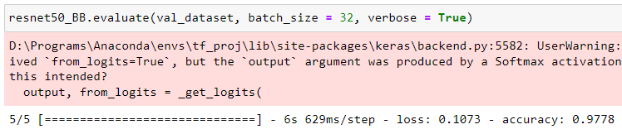
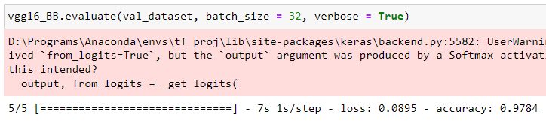
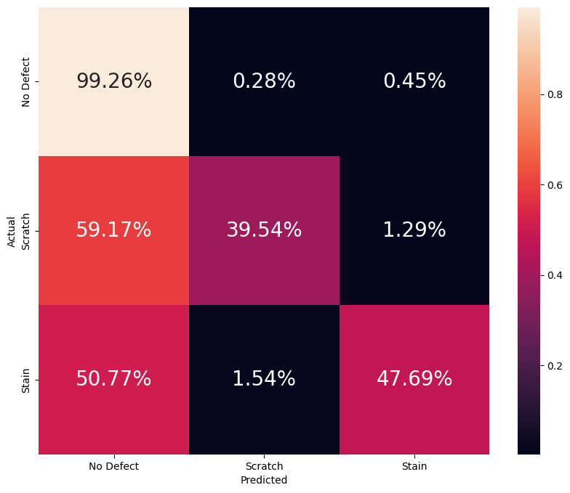
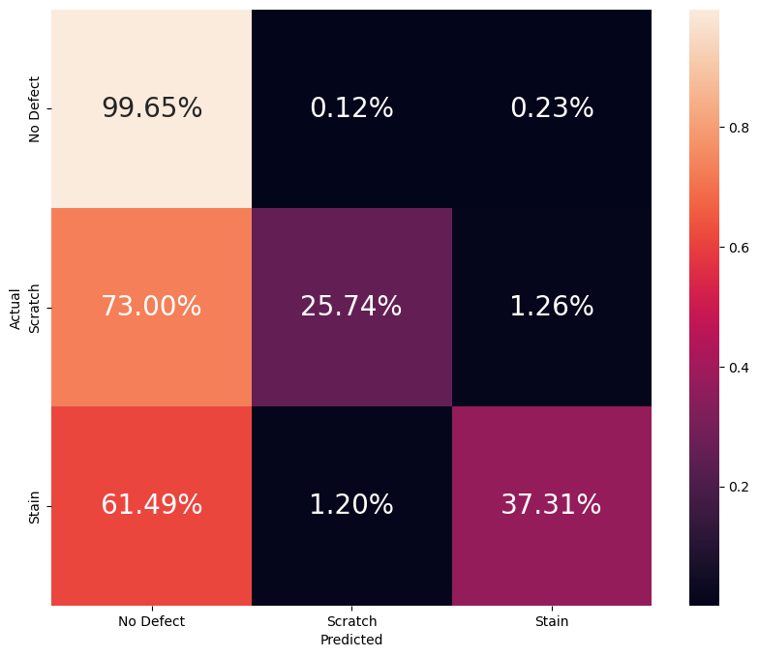
Resnet50 and Vgg16 Backbone
Segmentation Models library allows for implementation of other architectures as the backbone for U-net (the encoding portion). The package produces the decoding portion for you.
Transfer learning using pre-trained weights from imagenet.
Had to use batch size of 16 due to memory limitations and trained for 40 epochs.
Validation set evaluation comparison between three models.

Slide 11
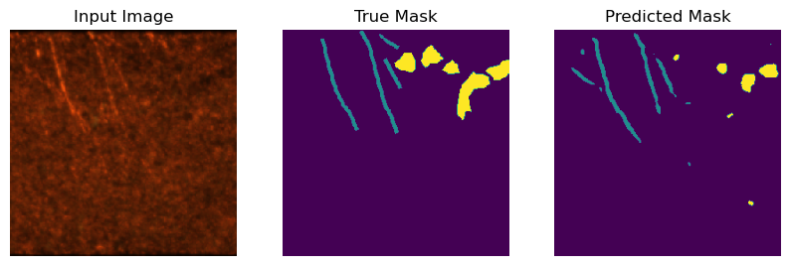
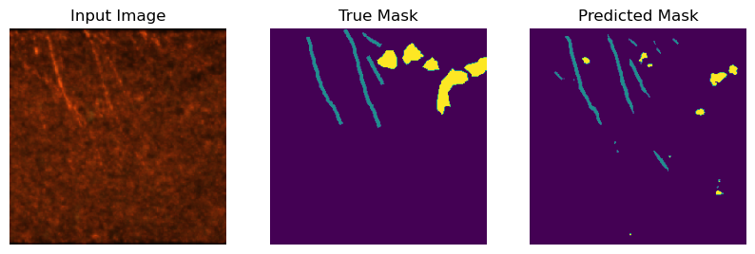
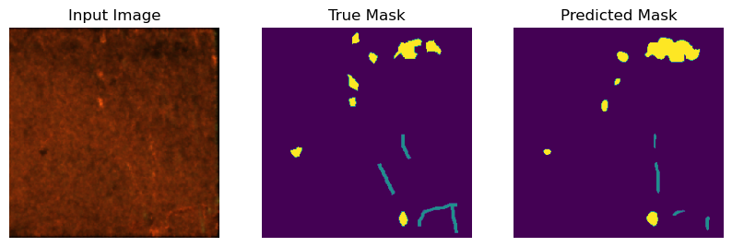
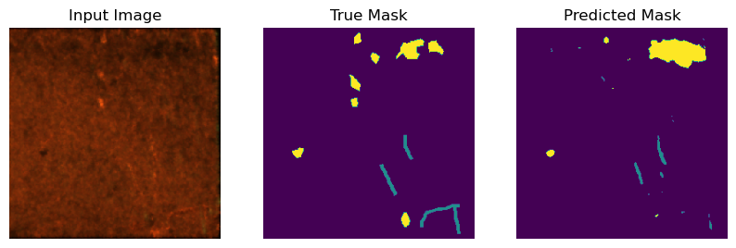
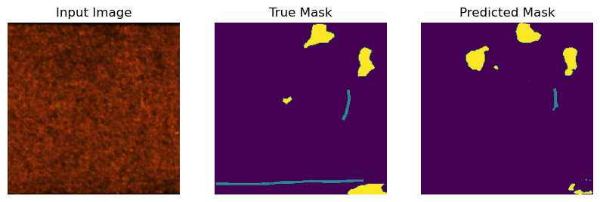
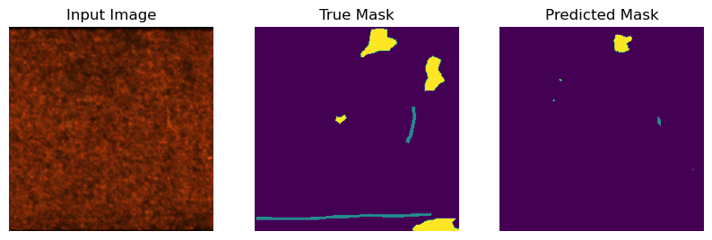
Resnet50 and Vgg16 Backbone Cont.
U-net
Resnet50
Vgg16

Slide 12
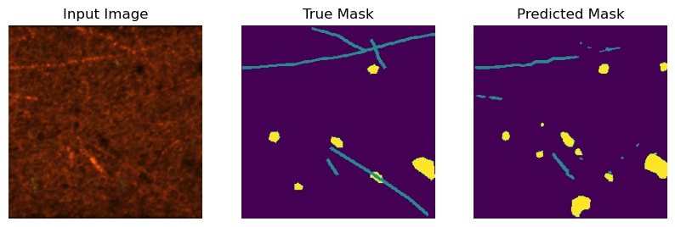
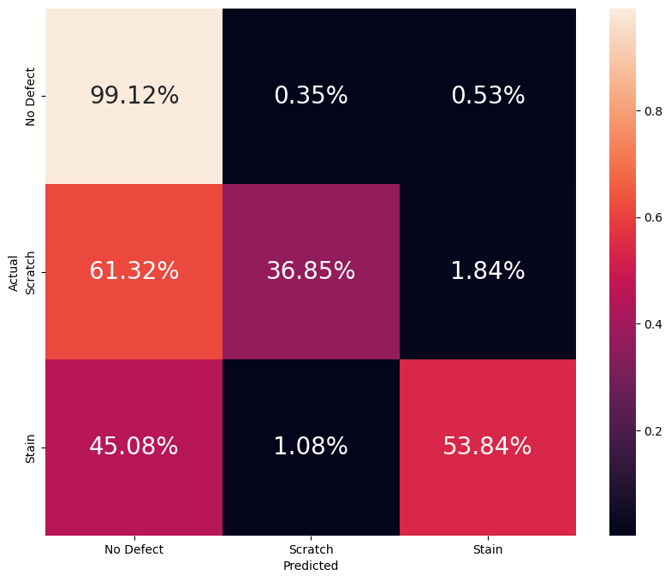
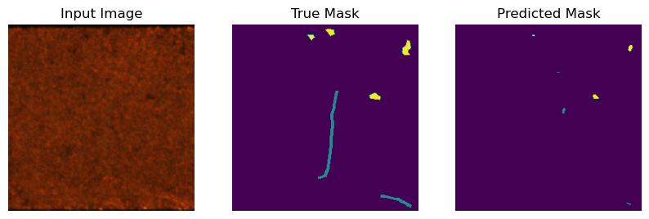
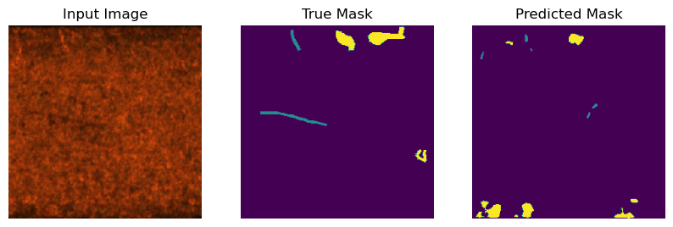
Test Set with Resnet50 Backbone
Test Set Confusion Matrix
Examples

Slide 13
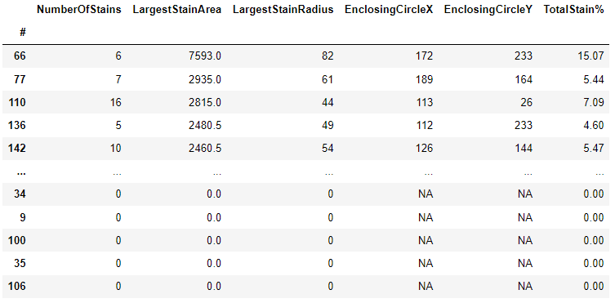
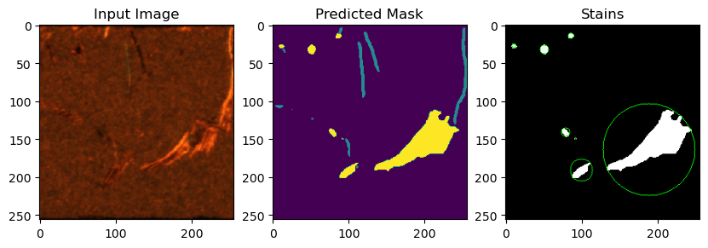
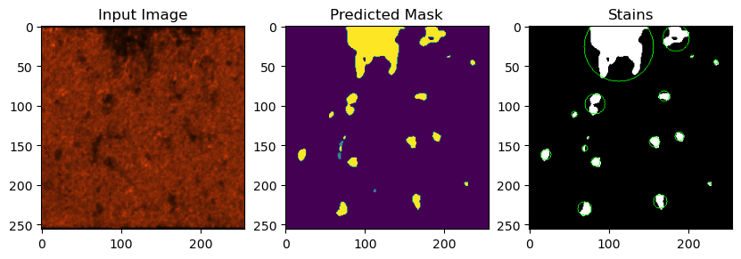
Post-Segmentation Image Analysis
After doing image segmentation, can use results to screen defective parts if there are established criteria.
Focusing on stains, change predicted masks to greyscale with only stains and background pixels.
Use OpenCV to locate contours (stains) and calculate areas as well as minimum enclosing circles and their locations.
Can be used to filter out faulty parts in manufacturing process.
Can be used to monitor process quality and incorporate statistical process control.
Can be used to conduct failure analysis and pinpoint processes contributing to failure rate.

Slide 14
Future Work
Can perhaps incorporate some data augmentation such as image rotation, flipping, etc., to increase dataset size.
Correct mislabeled cases or have better defined criteria for determining if defect is present and which type.
Can try other achitectures and see if performance improves. Can also train for longer.
For scratches, can implement rotated bounding rectangle and determine the length of the longer side as an estimate for the length of the scratch. This can be useful if there is specification regarding the maximum scratch length.
If it can be known which pictures come from any given part, then can study the location and size of defects to see if there is pattern. For instance maybe top right corner of part is always scratched, and maybe this can be traced back to an issue with the equipment.

Slide 15
THANKS
Please keep this slide for attribution

